Slide 1

Application of Deep Neural Network in Apple’s Siri Voice Detection
MIS 64061 - Final Project - Deep Learning Models
Tejasvini Mavuleti

Slide 2
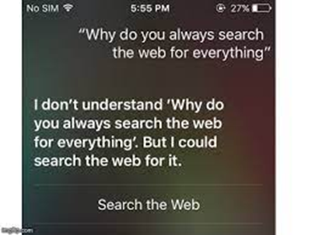
Problem
Speed and Accuracy of Siri’s response
Sound waves inside your body - make sequences of sounds in your device
Human machine interactions
Zillion types of sounds, cut, reassemble and speak out
Combinations of sounds - missed word, voice gravel, background noise
The speed at what you speak contains most of the information
Data labelling and response accuracy
Source of the response

Slide 3
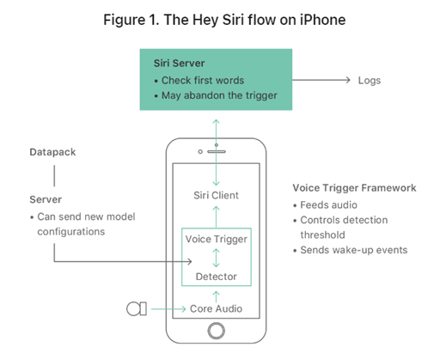
Why did I choose this topic?
Test the "Hey Siri" feature in Apple that allows users to invoke Siri as a hands-free feature.
Interface with using verbal commands and handwritten recognition
Siri parses the following speech as a command or query
Detector uses a Deep Neural Network (DNN) to convert the acoustic pattern
Develop and articulation between sounds, precise sound you make and the exact next word
Most importantly - found a link to NN assignment

Slide 4
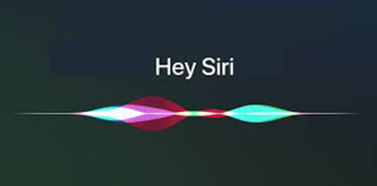
Introducing Siri’s best friend - NN
Trigger word detection - wake word
Voice modulation and speech emotions
Unusual words and combinations are identified
Updates the network in split seconds
New utterances - text to speech - label them - stored in the database
Take the waveform and make a spectrogram
Phonetic label, stress label, pitch label - label & play the answer back
6000 languages to translate

Slide 5
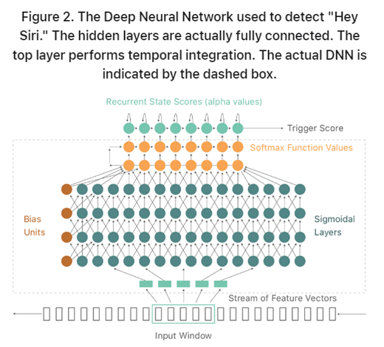
Domain & Application
65,000 one-second-long utterances of 30 short words, by thousands of different people
Voice into a stream of instantaneous waveforms
At a rate of 16000 wvf samples per second
Generating labelled training data
Self supervised model
Connects sigmoid layers to perform temporal integration
Converts each of the acoustic model
Keras - unique label, waveform, data recognition

Slide 6
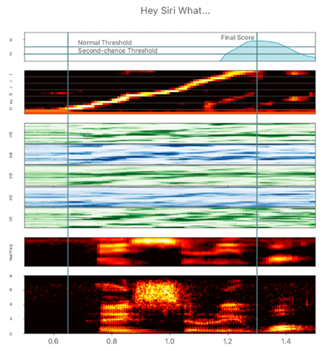
Technique
Speech recognition – recognize multiple voices
Trigger word detection – wake up words
TensorFlow - catch sound waves
Converting audio files(.wav) to spectrograms
Classifier inception – highest accuracy in classification
Tested convolution layers
Assigned weights and normalization
Found the model accuracy, loss, precision and recall
Translate – basic transformation of sound waves from get text to speech

Slide 7
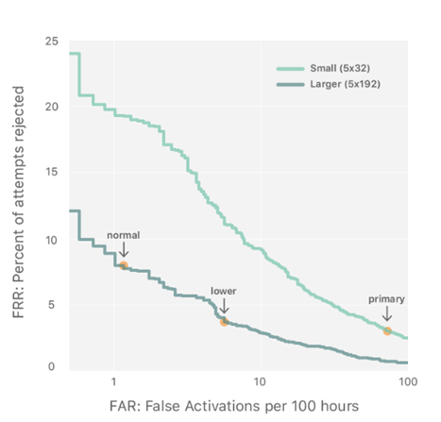
Development
Change the balance between two kinds of error by changing the activation threshold
These are early development models
Estimate the accuracy and observe the positive or negative result
Get back to include the failed attempts
False detection and false wakes
If there are any occurrences of the target phase - they are labeled and stored in the negative data
Does not count them as errors

Slide 8
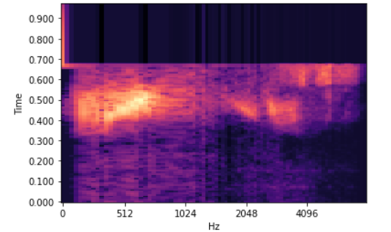
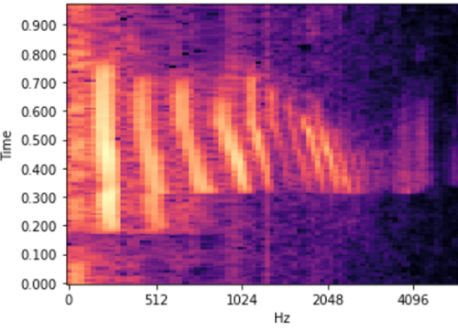
Conclusion
Data synthesis is an effective way to create a large training set for speech problems
Common pre-processing step is using a spectrogram and optionally a 1D conv layers to pass the data to a DNN.
An end-to-end deep learning approach
Processes the audio data asynchronous from the input audio streaming to avoid breaking audio streaming.
A sliding/moving input window is an effective way to reduce delay.
Make sure you be nice to Siri !

Slide 9
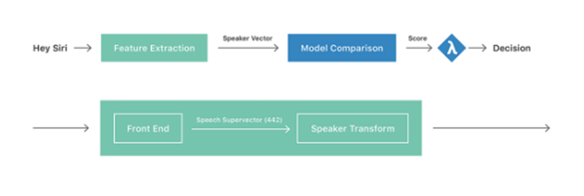
Contributions
Speech Vs. Sound
Develop my kind of unique model
TWD has important role as the entry point of user's communication
Same word - different sound waves
Understand the background of acoustic models
Model generalization of different words and noise
Identify supervised and unsupervised audio classes
Importance of product effectiveness and accessibility

Slide 10
What’s next?
TWD + Gender + Genre + Location + Translate
Tested the translate
Sensitive topic that I am skeptical about - Gender
Working on the Genre
Know the location of the device and match up with the questions
Build a hypothesis on the interlink

Slide 11
References
Deep learning for siri's voice: On-device deep mixture density networks for hybrid unit selection synthesis. Apple Machine Learning Research. (n.d.). Retrieved December 13, 2022, from https://machinelearning.apple.com/research/siri-voices
Doshi, K. (2021, May 21). Audio deep learning made simple (part 2): Why Mel Spectrograms perform better. Medium. Retrieved December 13, 2022, from https://towardsdatascience.com/audio-deep-learning-made-simple-part-2-why-mel-spectrograms-perform-better-aad889a93505
Hall, Z. (2017, October 18). Apple explains how 'hey Siri' works using a deep neural network and machine learning. 9to5Mac. Retrieved December 7, 2022, from https://9to5mac.com/2017/10/18/how-hey-siri-works/
Hey Siri: An on-device DNN-powered voice trigger for Apple's personal assistant. Apple Machine Learning Research. (n.d.). Retrieved December 13, 2022, from https://machinelearning.apple.com/research/hey-siri
Inc., A. (n.d.). Human interface guidelines. Human Interface Guidelines - Human Interface Guidelines - Design - Apple Developer. Retrieved December 13, 2022, from https://developer.apple.com/design/human-interface-guidelines/guidelines/overview
Levy, S. (2016, August 24). An exclusive look at how AI and machine learning work at Apple | Backchannel. Wired. Retrieved December 7, 2022, from https://www.wired.com/2016/08/an-exclusive-look-at-how-ai-and-machine-learning-work-at-apple/
Lutkevich, B., & Kiwak, K. (2021, September 13). What is speech recognition? Customer Experience. Retrieved December 13, 2022, from https://www.techtarget.com/searchcustomerexperience/definition/speech-recognition
Manankshastri. (n.d.). Build software better, together. GitHub. Retrieved December 13, 2022, from https://github.com/manankshastri/Trigger-Word-Detection/projects
Personalized hey Siri. Apple Machine Learning Research. (n.d.). Retrieved December 7, 2022, from https://machinelearning.apple.com/research/personalized-hey-siri
Quora insincere questions classification. Kaggle. (n.d.). Retrieved December 7, 2022, from https://www.kaggle.com/competitions/quora-insincere-questions-classification/rules
Saini, K. (2019, September 16). Natural language processing ft. Siri. Medium. Retrieved December 13, 2022, from https://medium.com/mytake/natural-language-processing-ft-siri-2bc7b854a2a3
Sanger. (n.d.). DPL-425 - as an R&D scientist I would like add hi-C quants to quanthub to automate the process to reduce the time and effort taken to perform quants, persist the quants, support the pooling and reduce the chances for errors · issue #169 · Sanger/quanthub. GitHub. Retrieved December 13, 2022, from https://github.com/sanger/quanthub/issues/169
Sharma, A. (2020, June 2). Behind hey Siri: How Apple's AI-powered personal assistant uses DNN. Analytics India Magazine. Retrieved December 7, 2022, from https://analyticsindiamag.com/behind-hello-siri-how-apples-ai-powered-personal-assistant-uses-dnn/
Speech recognition - human car interaction. (n.d.). Retrieved December 13, 2022, from http://humancarinteraction.com/speech-recognition.html
Speech recognition using Deep Learning on Intel® Architecture. Intel. (n.d.). Retrieved December 13, 2022, from https://www.intel.com/content/www/us/en/developer/articles/technical/speech-recognition-using-deep-learning-on-intel-architecture.html
TensorFlow speech recognition challenge. Kaggle. (n.d.). Retrieved December 7, 2022, from https://www.kaggle.com/competitions/tensorflow-speech-recognition-challenge
Writer, G. (2022, May 4). Emotional AI: Are algorithms smart enough to decipher human emotions? IoT For All. Retrieved December 13, 2022, from https://www.iotforall.com/emotional-ai-are-algorithms-smart-enough-to-decipher-human-emotions

Slide 12

Questions!

